Slide 1
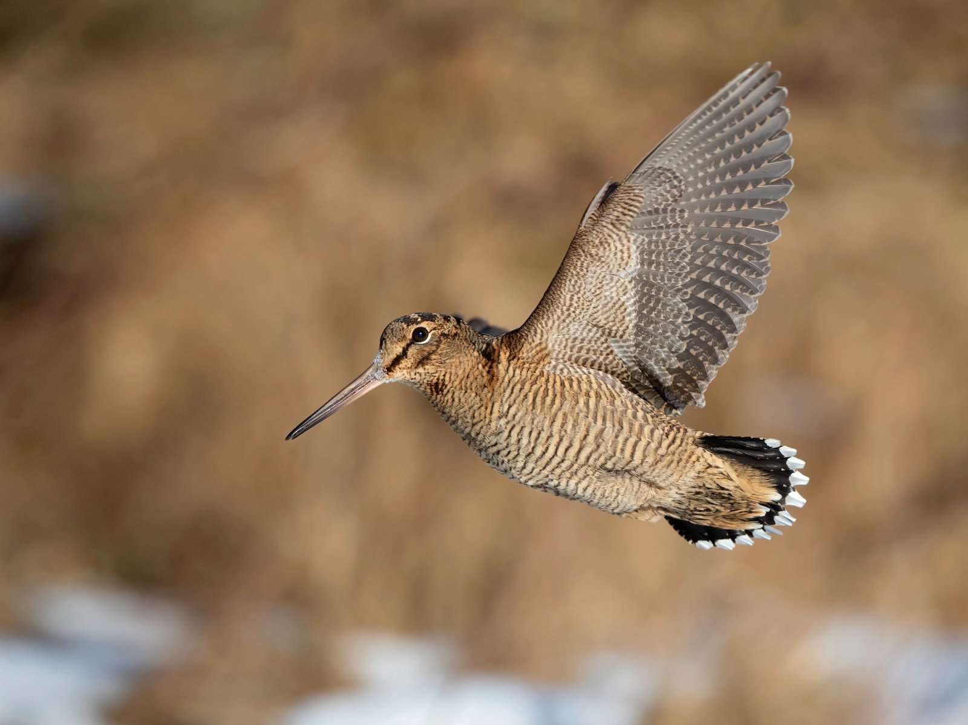
Woodcock autumn migration and hunting: Are local Swiss birds exposed to hunting pressure?
Pierre Mollet
Martin Grüebler
Steffen Oppel
Elizabeth Yohannes
Gilberto Pasinelli

Slide 2
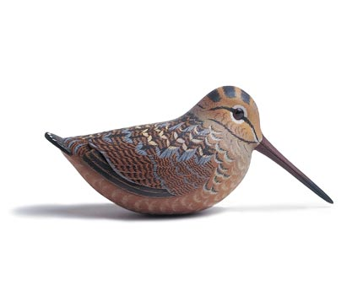
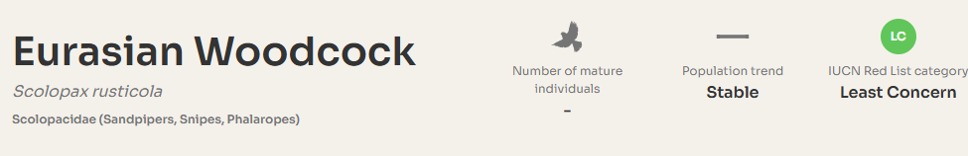

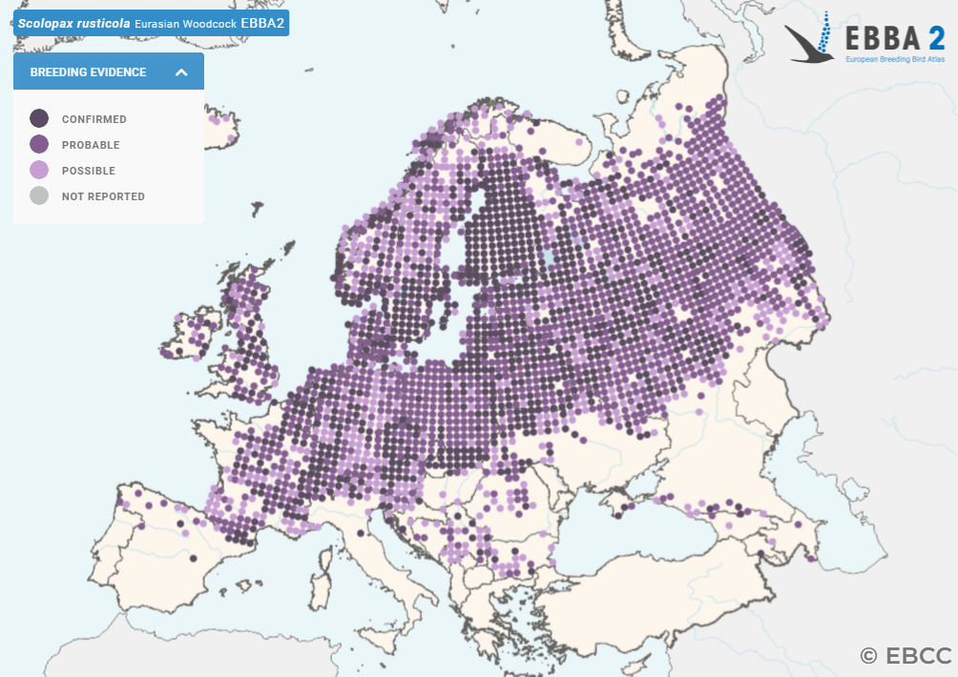
Status of woodcock in Europe

Slide 3
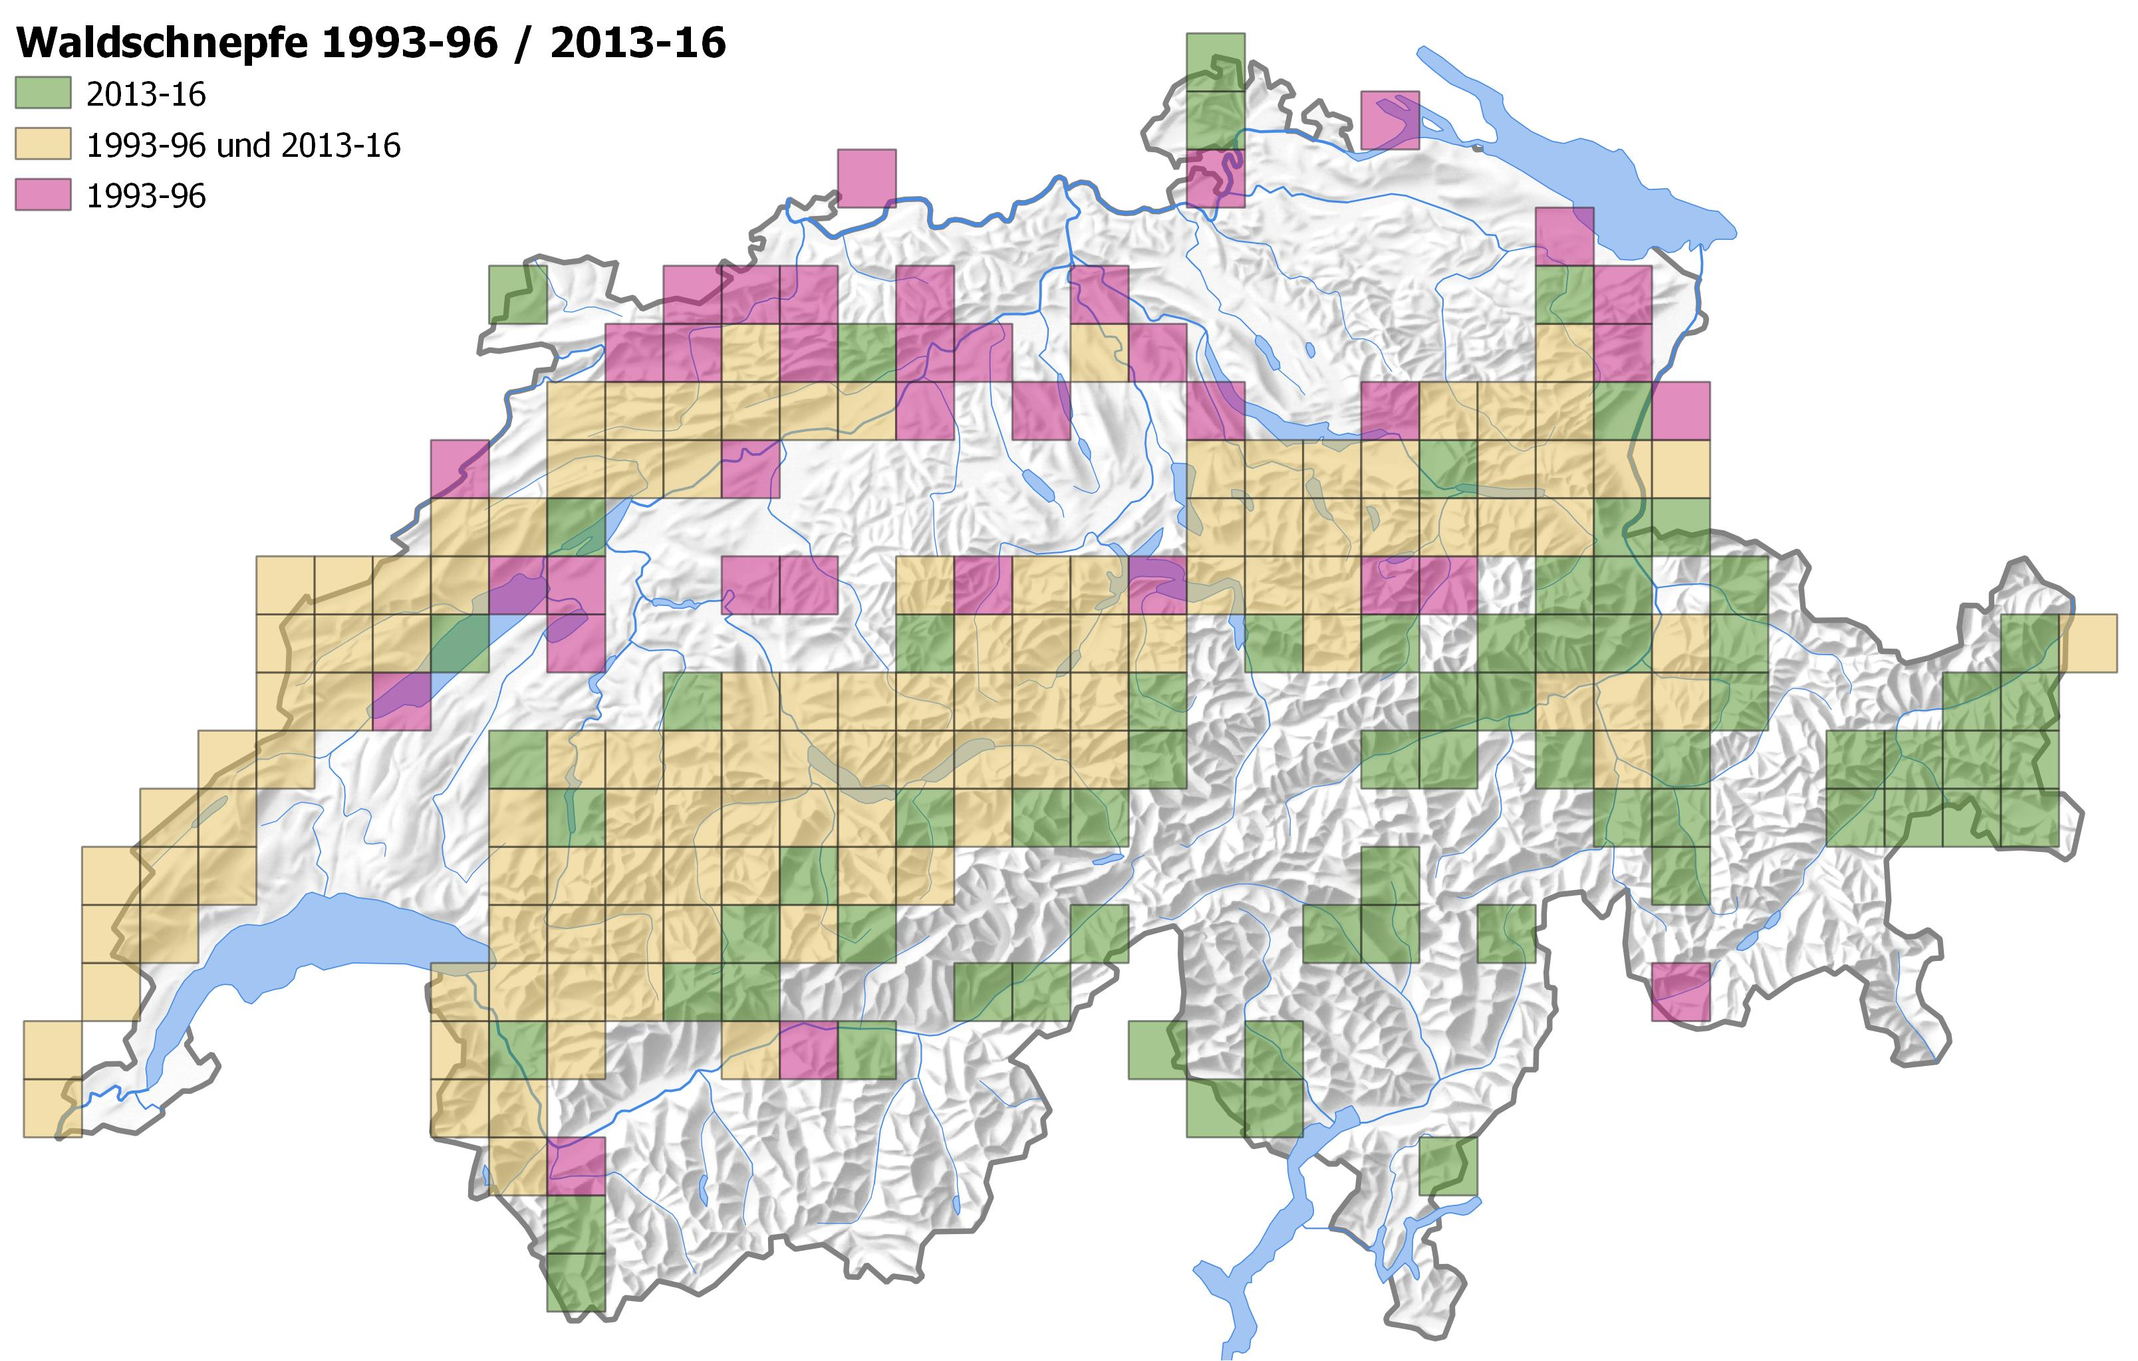
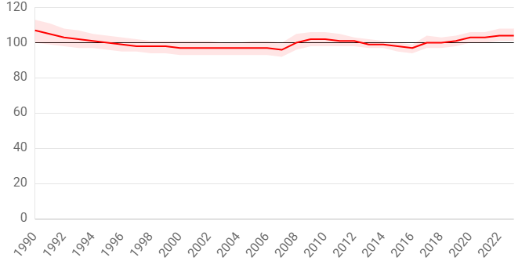
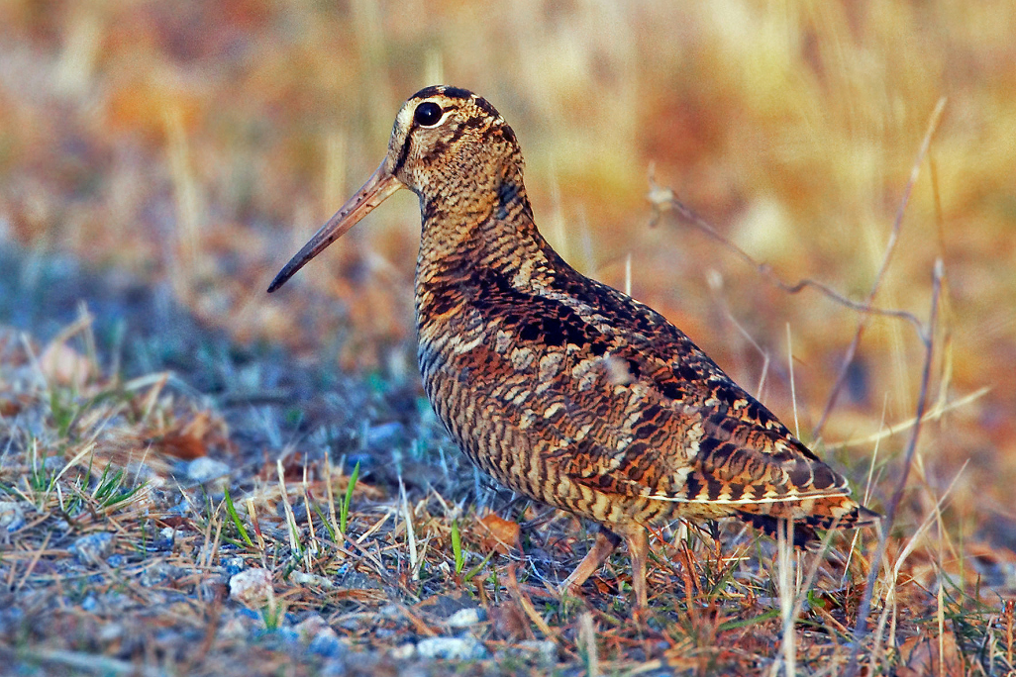
Status of woodcock in Switzerland
breeding population size 1000 – 4000 roding males
woodcock distribution range more or less stable, but vanished from lowlands and some parts of the Eastern Jura

Slide 4
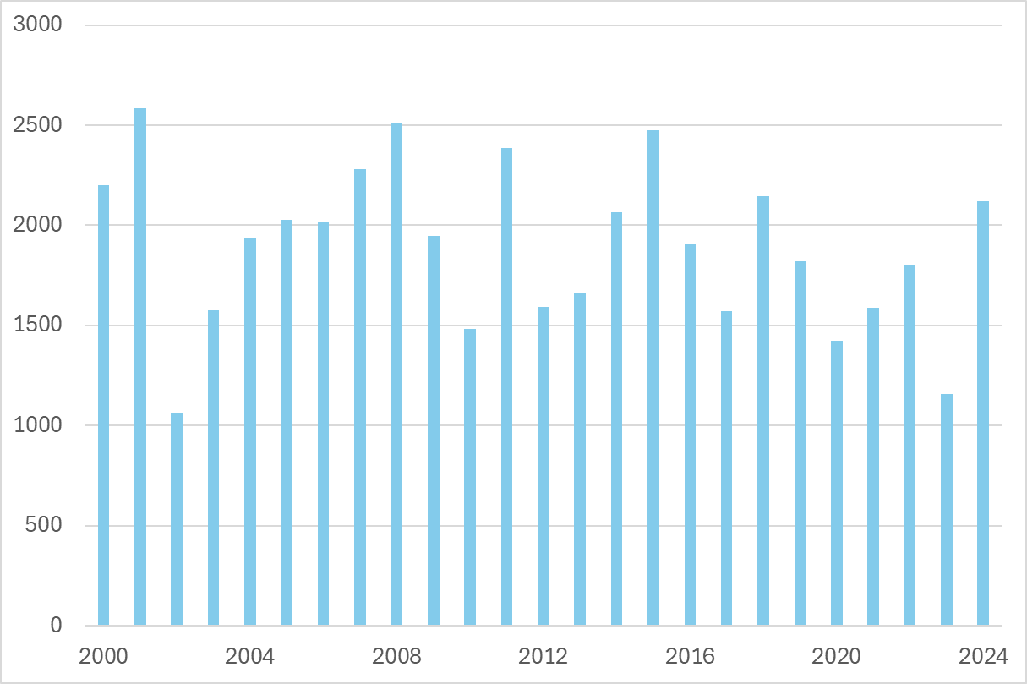
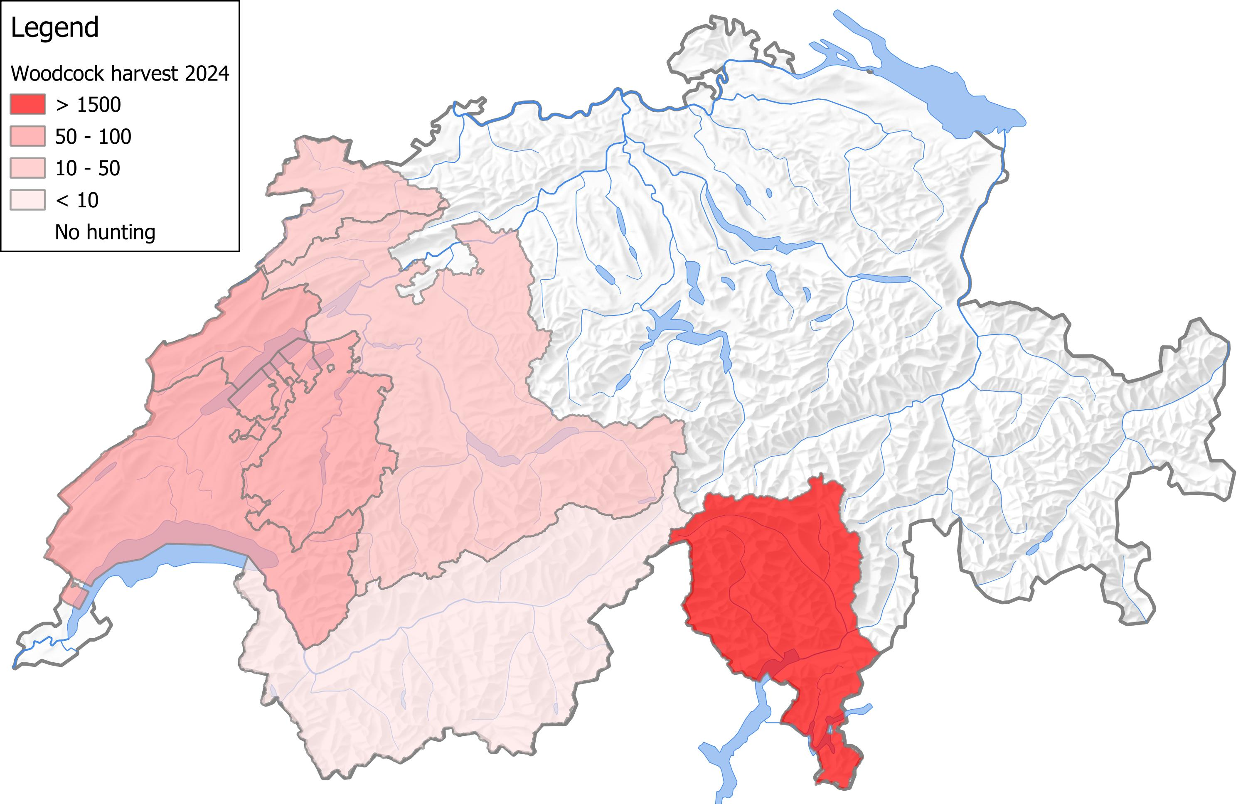
Woodcock hunting in Switzerland
Harvest 2024: 2120 birds (average from 2000 to 2024: 1820) – most birds shot must be migrants
Number of woodcocks shot per year in Switzerland
Woodcocks shot in 2024 per canton
32
65
25
67
63
1864
4

Slide 5
Woodcock hunting in Switzerland
hunting season in Switzerland (federal law) from 16th September to 15th December
additional restrictions by the cantons (temporal and maximum harvest), f.ex. NE:
max. 3 birds between 20.10. and 31.10. and again max. 12 birds between 1.11. and 15.12.

Slide 6
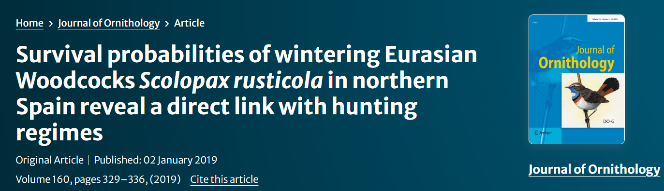
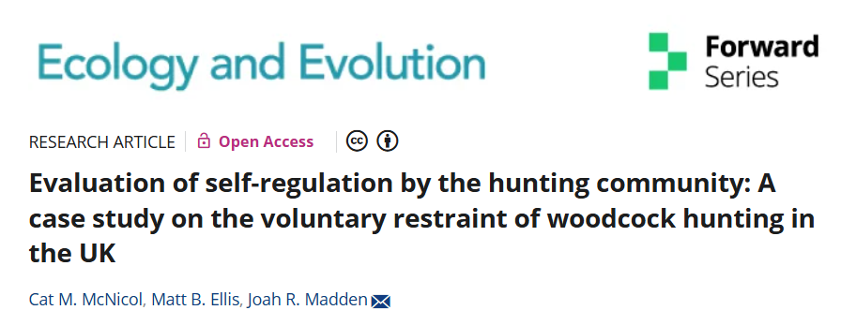
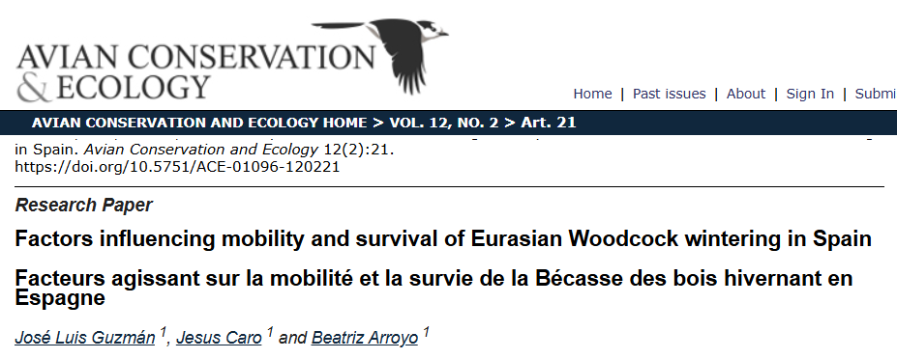
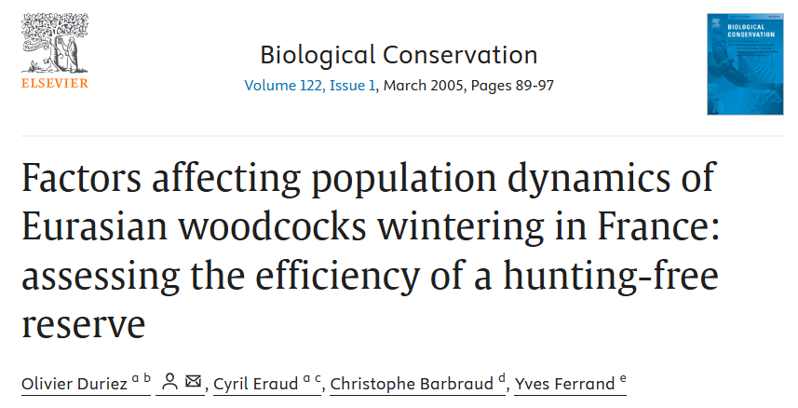
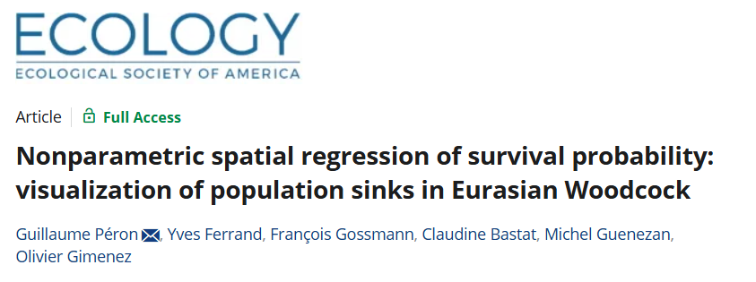
Hunting causes mortality and population declines
evidence from other countries that hunting effort reduces survival
populations in France and Spain decreasing due to unsustainable hunting levels

Slide 7
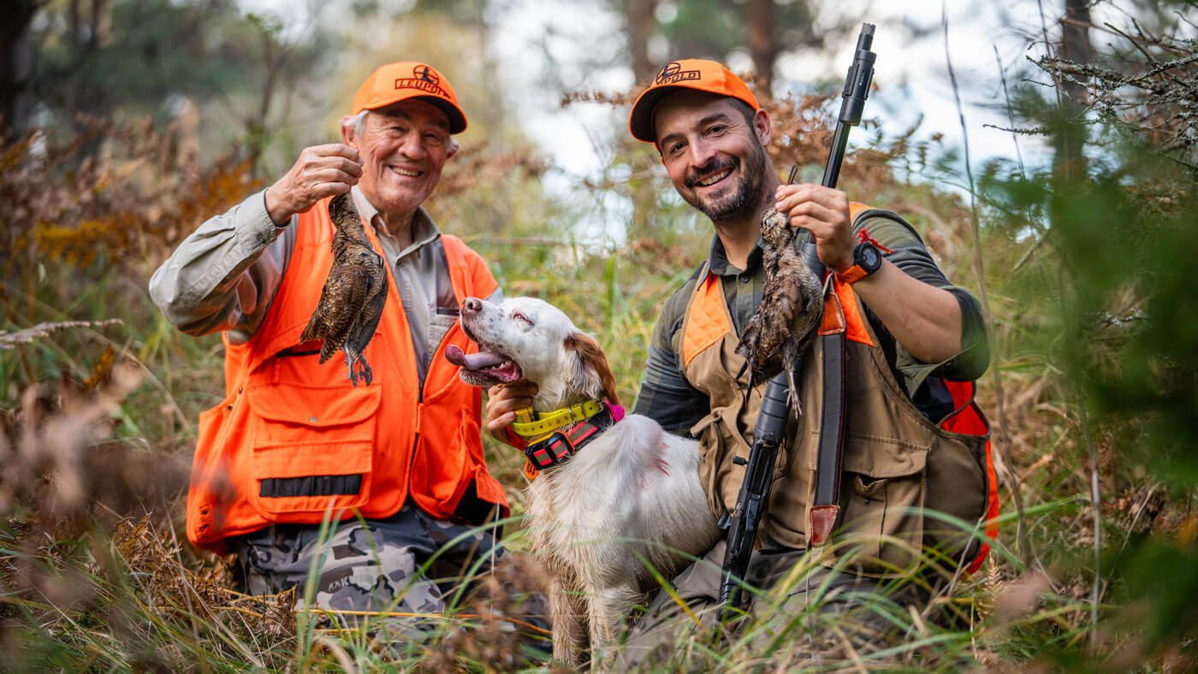
How does hunting affect woodcocks in Switzerland?
When do Swiss woodcocks depart from Switzerland?
What proportion of shot woodcocks are of local origin?

Slide 8
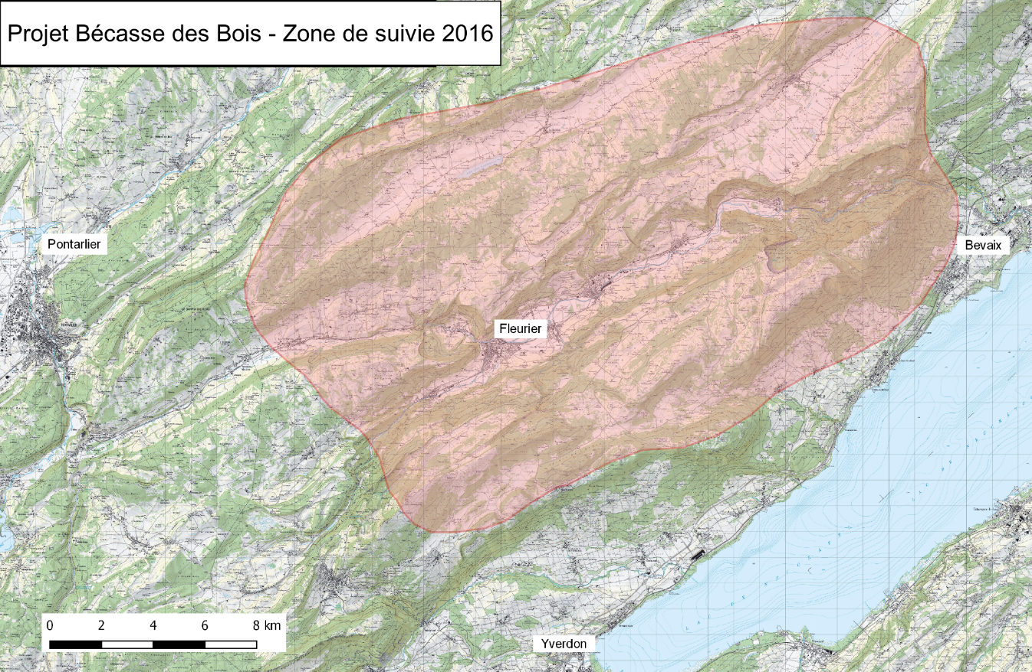
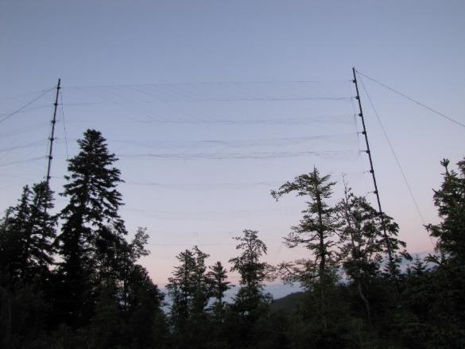
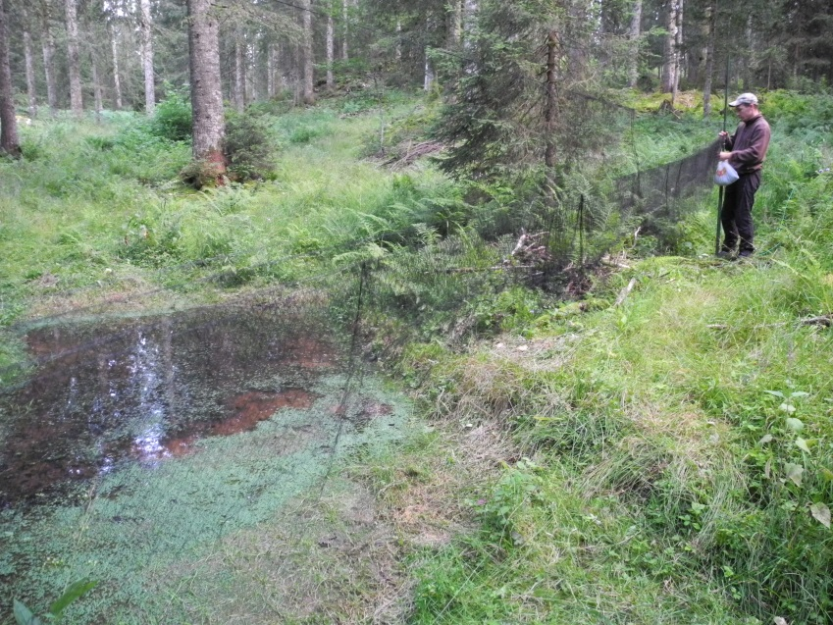
Field data collection 2005 – 2018 in Jura
captured birds with a) mistnets and b) spotlights and handnets
ringed a total of 472 individual woodcocks

Slide 9
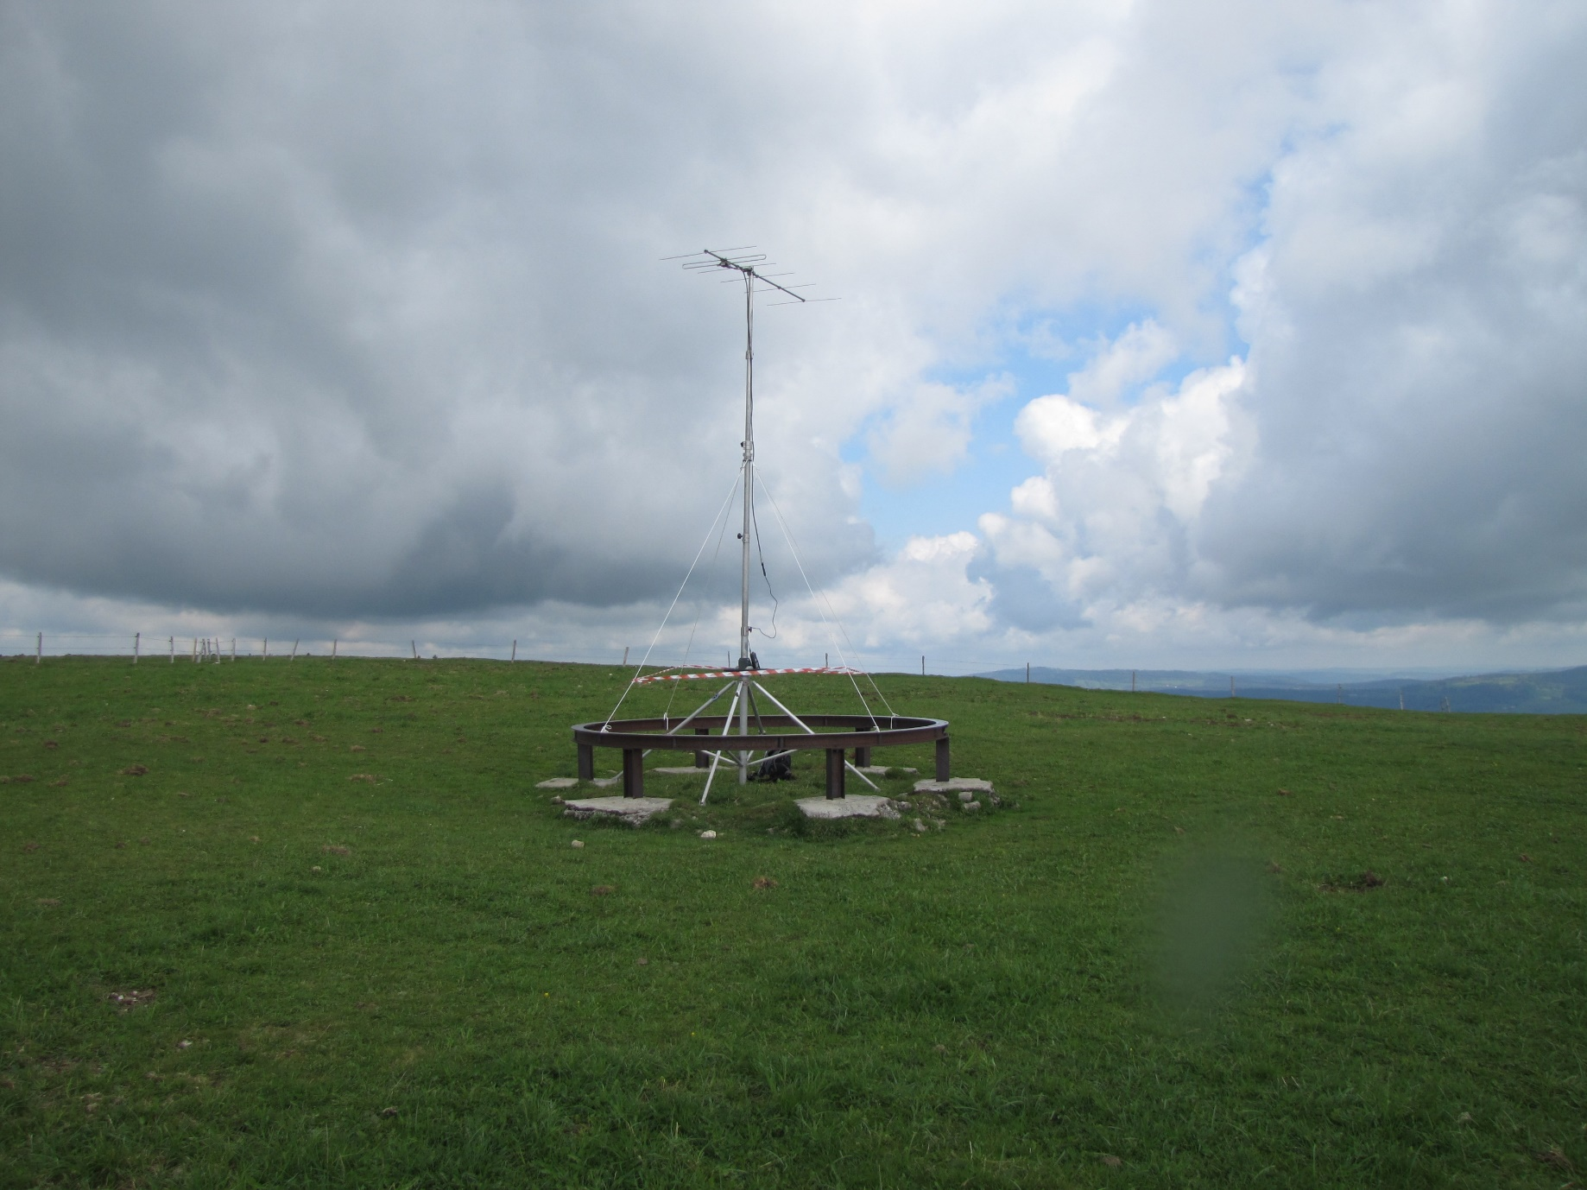
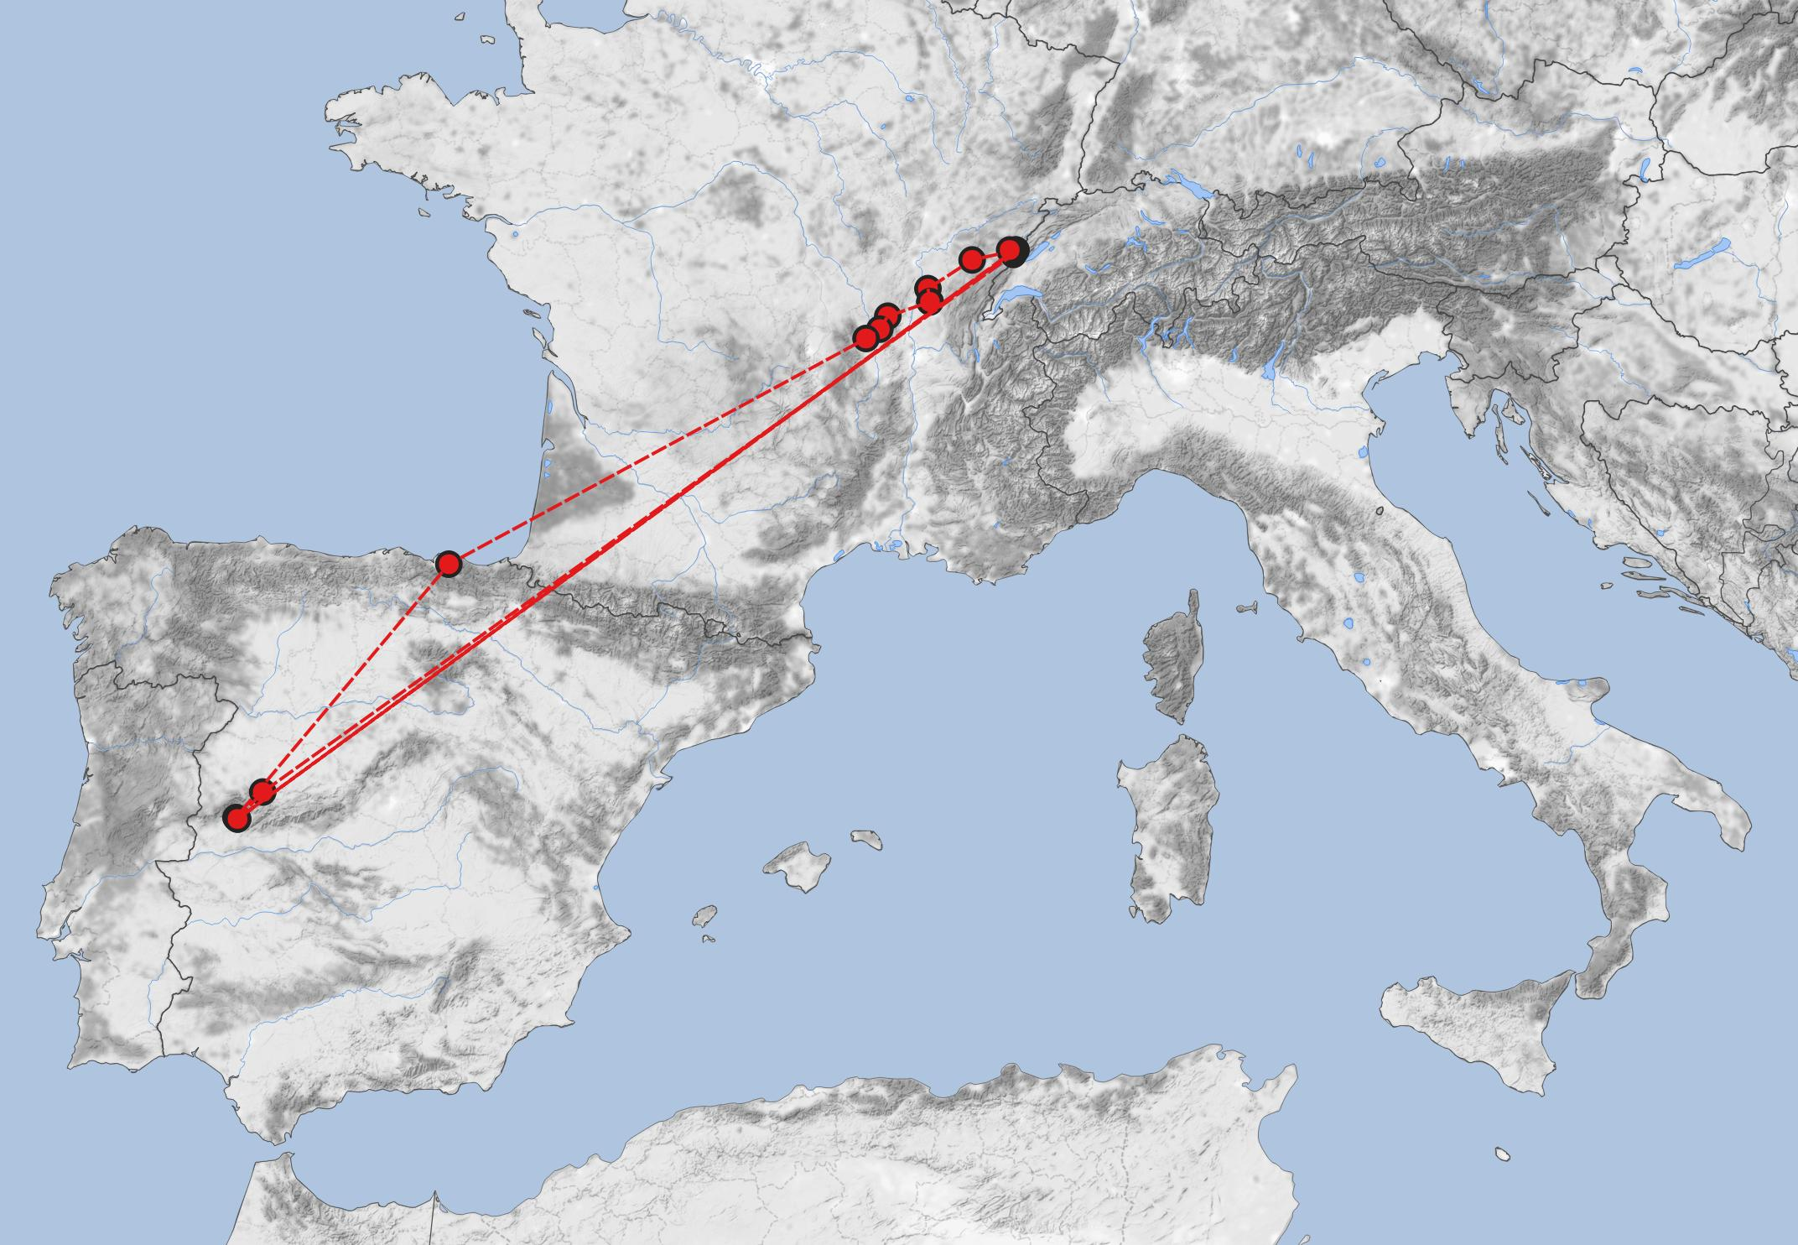
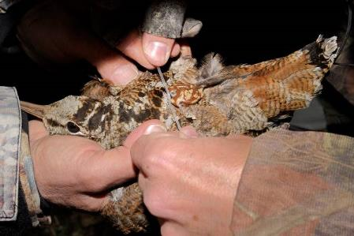
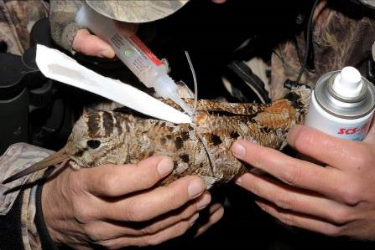
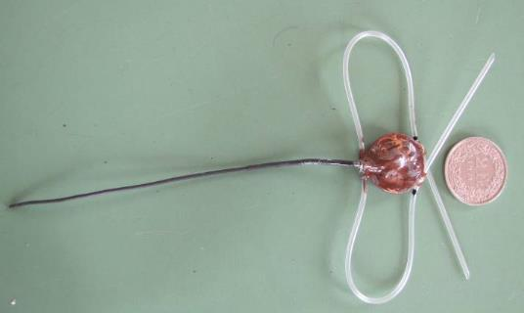
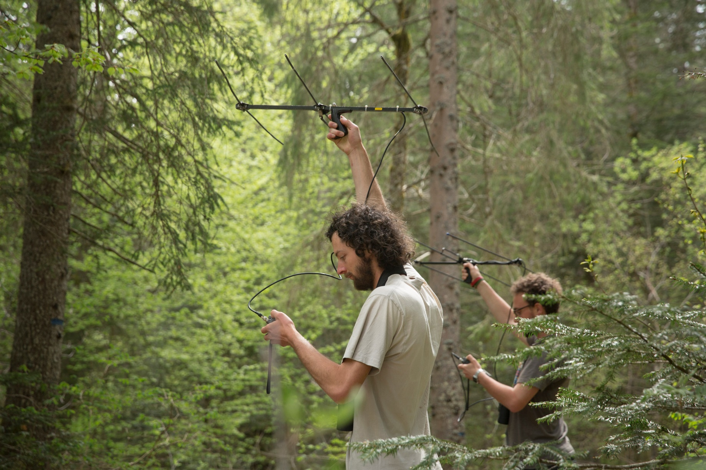
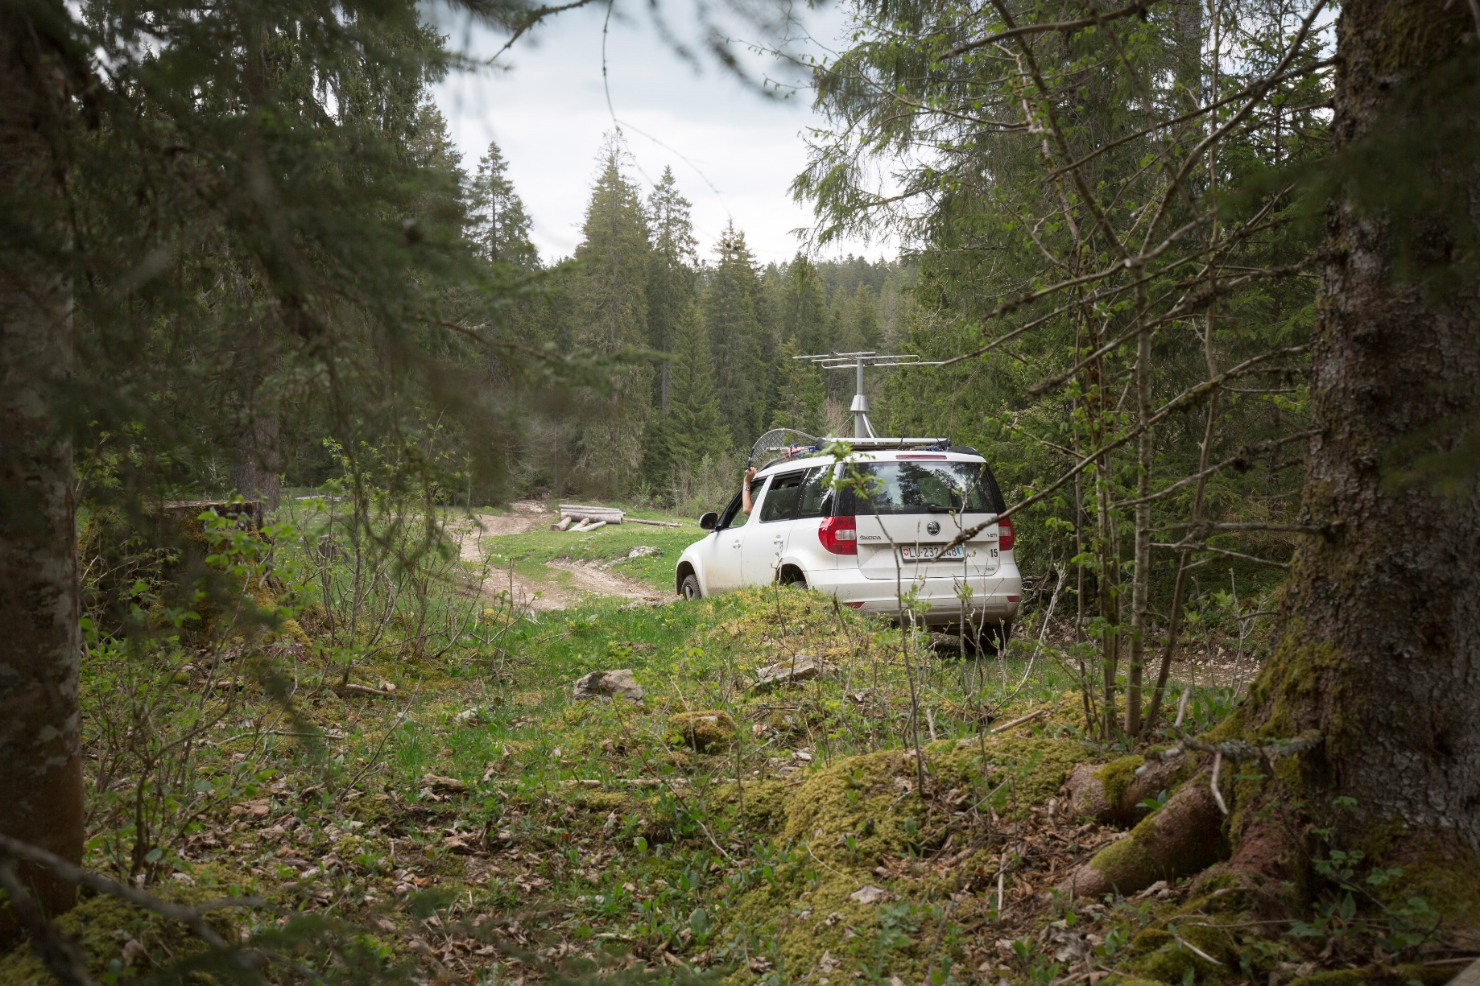
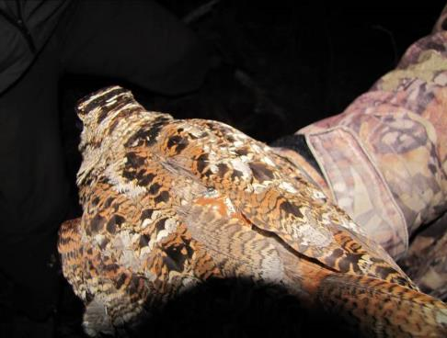
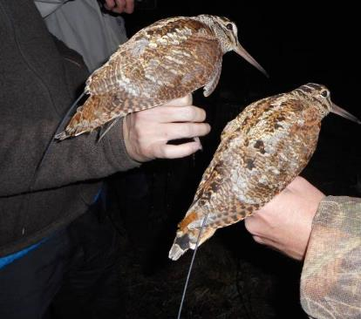
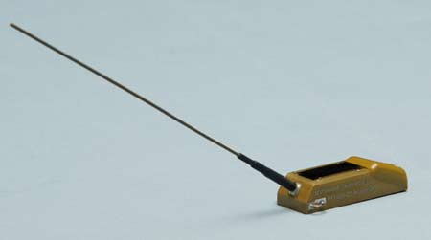
Telemetry of woodcocks
attached two types of transmitters to birds (VHF or satellite)
weekly efforts to relocate tagged birds by VHF
satellite telemetry also provides data on migration
1.7.2016 - 1.11.2016
2.7.2017 – 24.10.2017
17.7.2018 – 28.7.2018
3.11.2016
12.11.2016
19.11.2016 – 19.2.2017
6.11.2017 – 27.2.2018

Slide 10
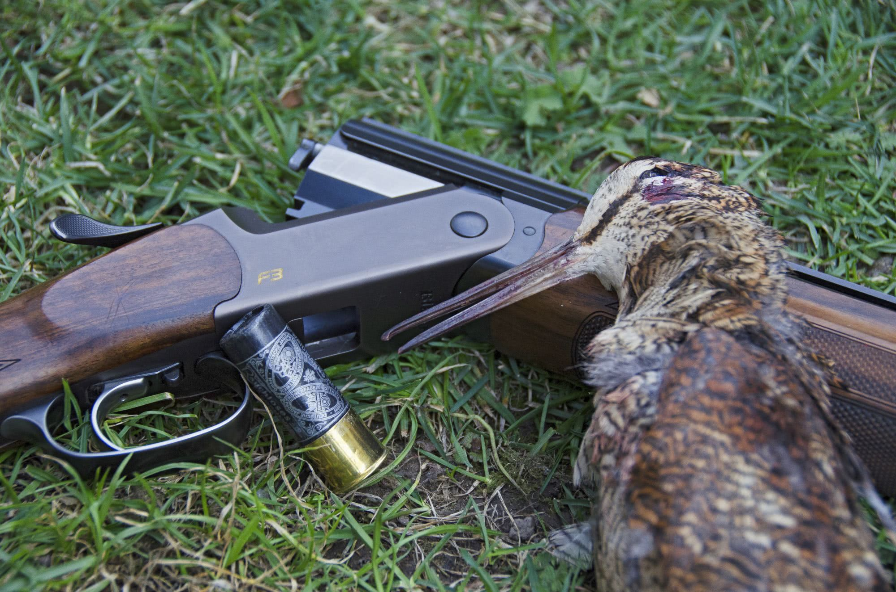
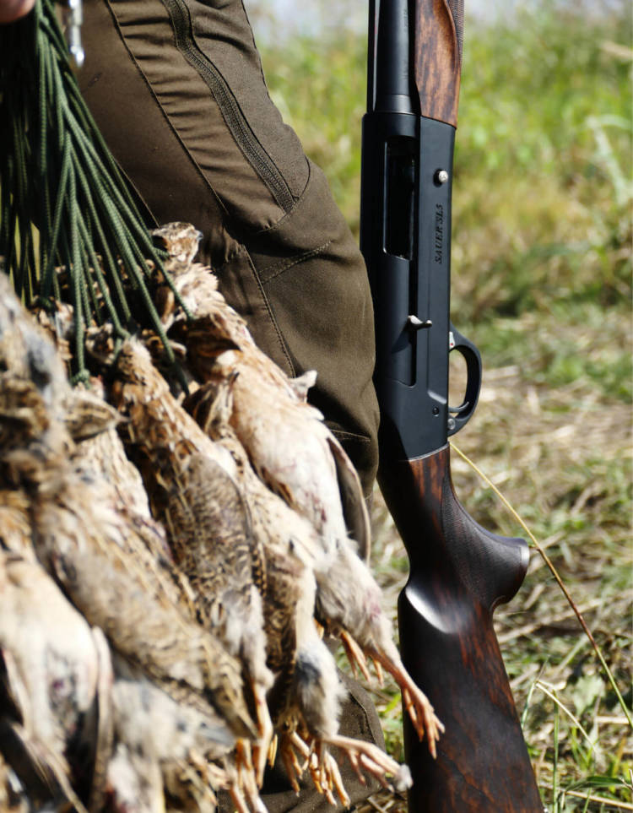
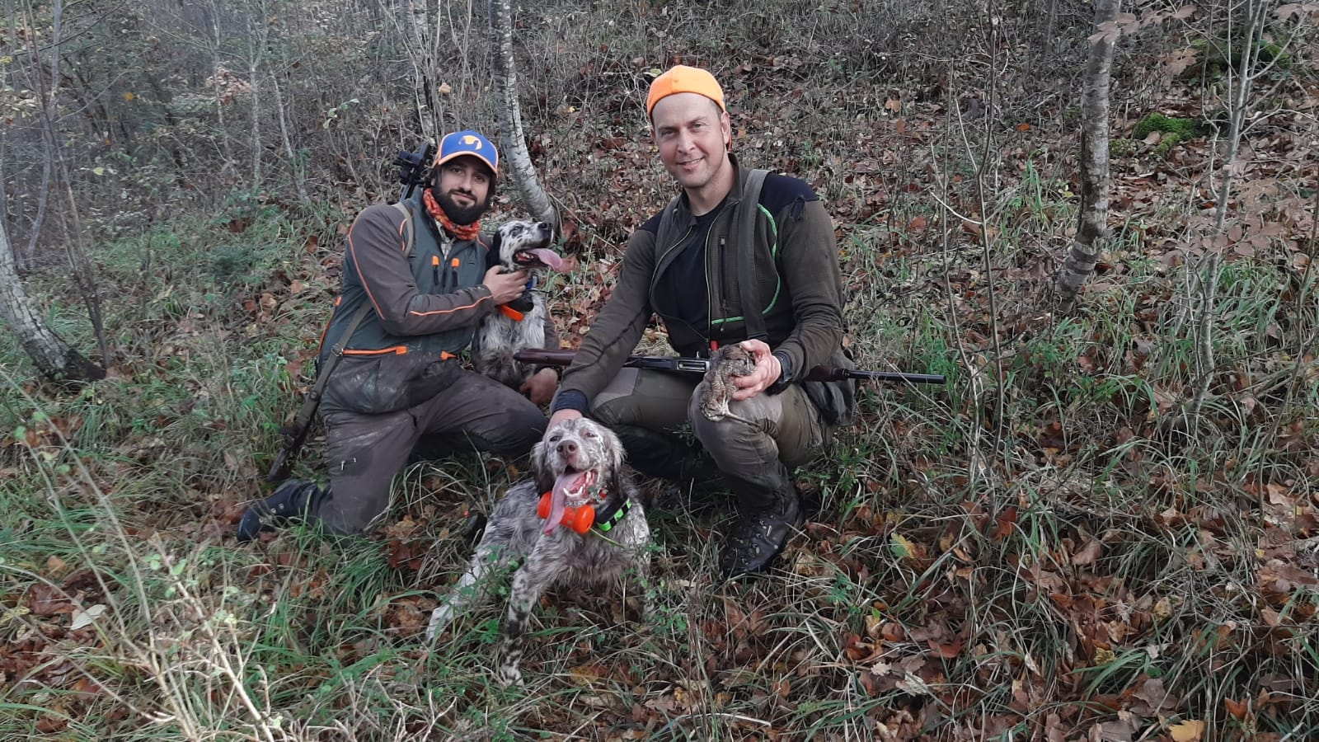
Feather collection of woodcocks
collected feathers of 72 woodcocks caught during breeding season (known origin)
asked hunters to provide wing feathers from 2013 – 2017 (n = 842)
analysed hydrogen isotope ratios in feathers
acquired data of another 134 woodcock samples across Europe (known origin)

Slide 11
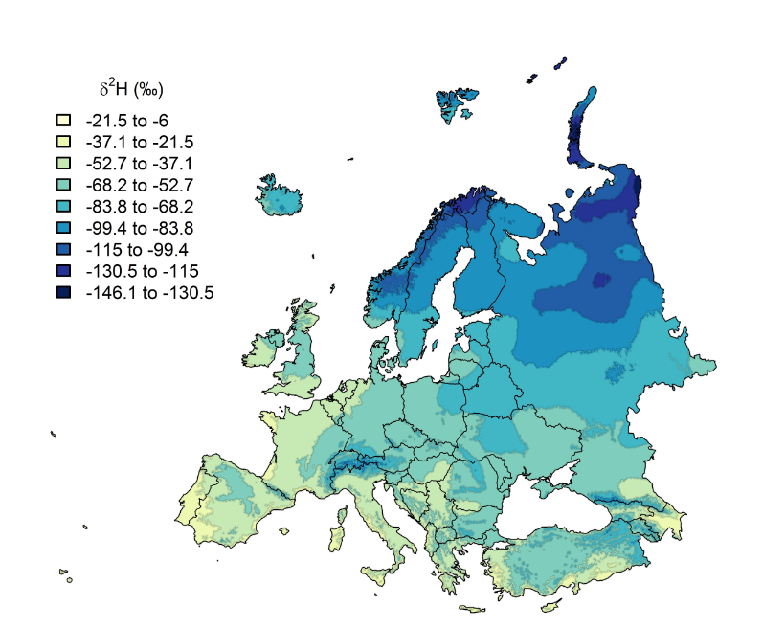
Background on geographic assignment with isotopes
geographic patterns of isotope ratios in rainwater due to circulation processes
heavy isotope rains out -> higher elevations and more continental areas usually depleted in ²H_{rain} (more negative hydrogen isotope ratio δ²H_{rain})
this geographic pattern can potentially be used to infer origins of birds

Slide 12
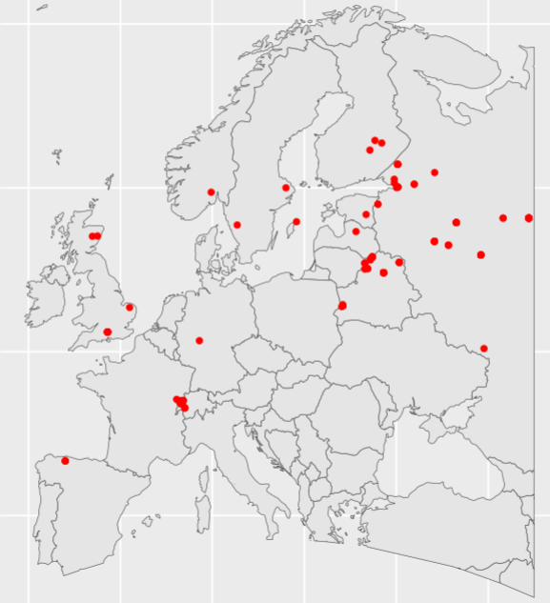
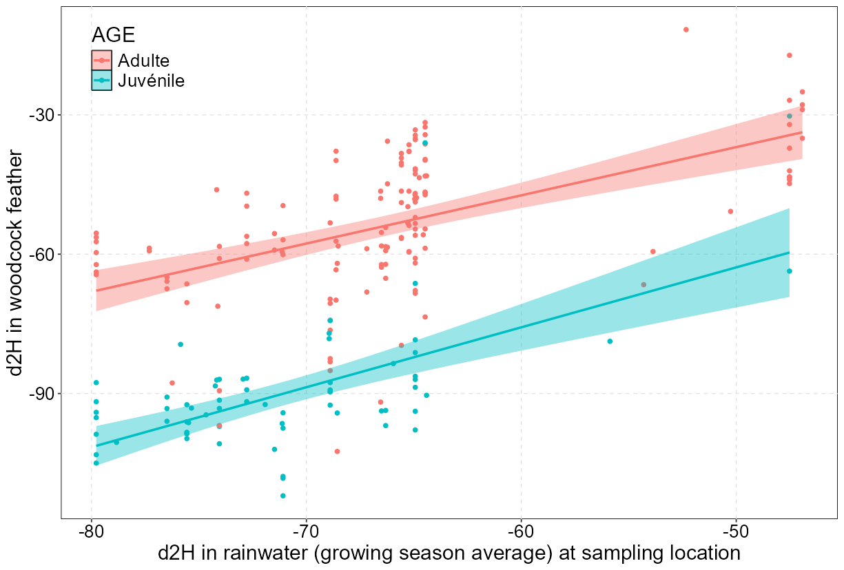
Limitations of geographic assignment
δ²H_{rain} does not necessarily reflect the dietary source for birds
fractionation between diet and feather leads to depletion of δ²H_{feather}
using our known-origin samples we calibrated this relationship

Slide 13
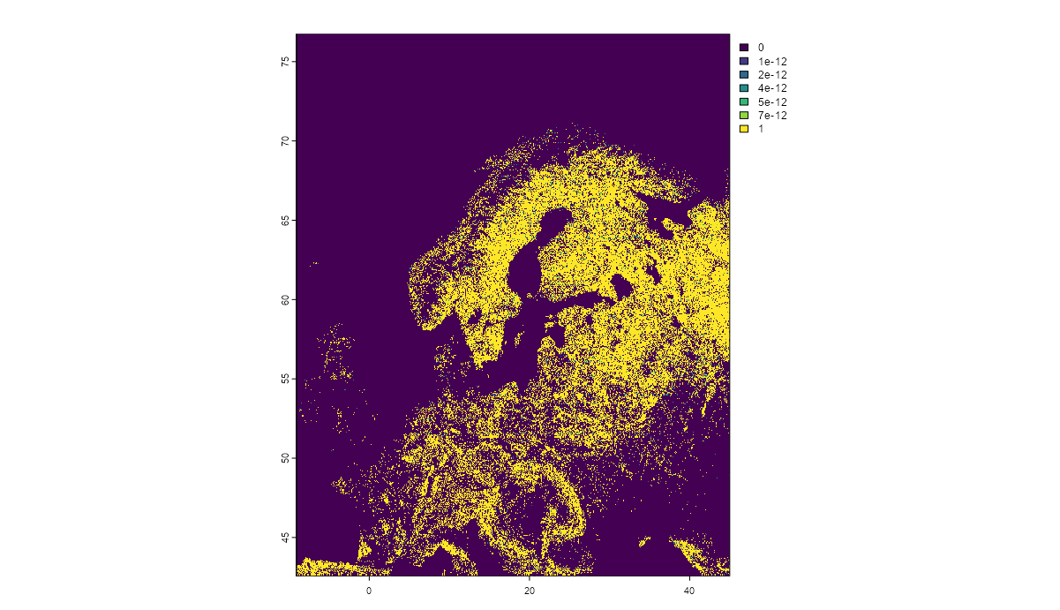
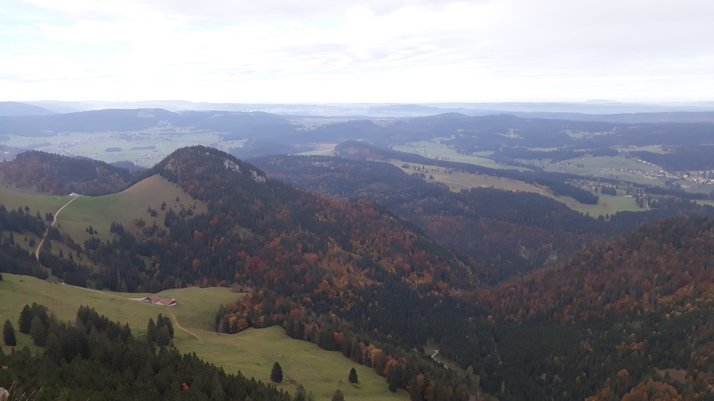
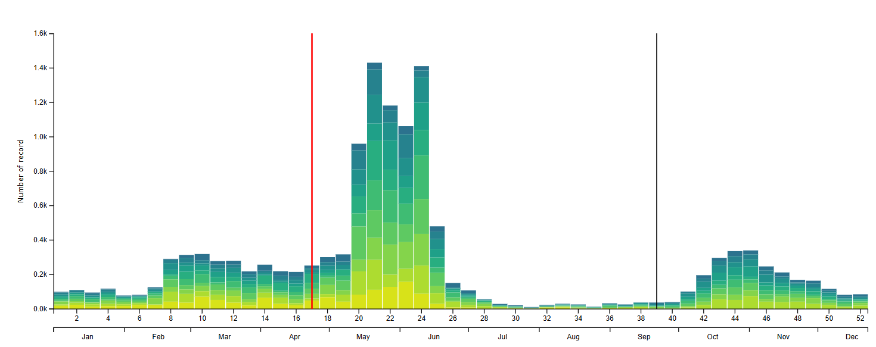
Model to estimate probability of origin
model solely to distinguish whether shot birds are local or not
feathers of known origin to calibrate relationship between δ²H_{feather} and δ²H_{rain}
overlayed forest layer with woodcock range map and sampled possible distribution of rainwater δ²H_{rain} from across the plausible woodcock distribution
for each shot woodcock, specified δ²H_{feather} distribution for shooting location
estimated probability that shot woodcock δ²H_{feather} comes from local distribution
included abundance phenology and migration probability as prior for local origin

Slide 14
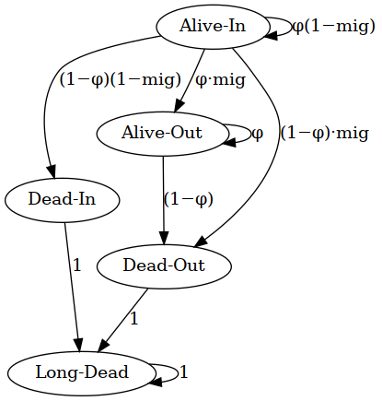
Model to estimate departure timing
estimated weekly presence in study area with a multi-event model
birds could be alive inside or outside study area, or dead inside or outside
detection probability differed between marks (ring, VHF, satellite tag)

Slide 15
Results – the basic raw numbers
Ringed birds | Total | 472
 | Breeding season (May to August) | 99
 | Migration season (March, April and September to Decermber) | 373
Equipped | Total | 85
 | VHF radio transmitters | 55
 | Satellite transmitters | 30
Found dead | Total | 10
 | Predation | 9
 | Unknown | 1
Shot | Total | 97
 | Switzerland | 8
 | North-eastern France | 30
 | Rest of France | 39
 | Spain / Portugal | 17
 | Russia | 3
Never re-recorded |  | 300
21%
77%

Slide 16
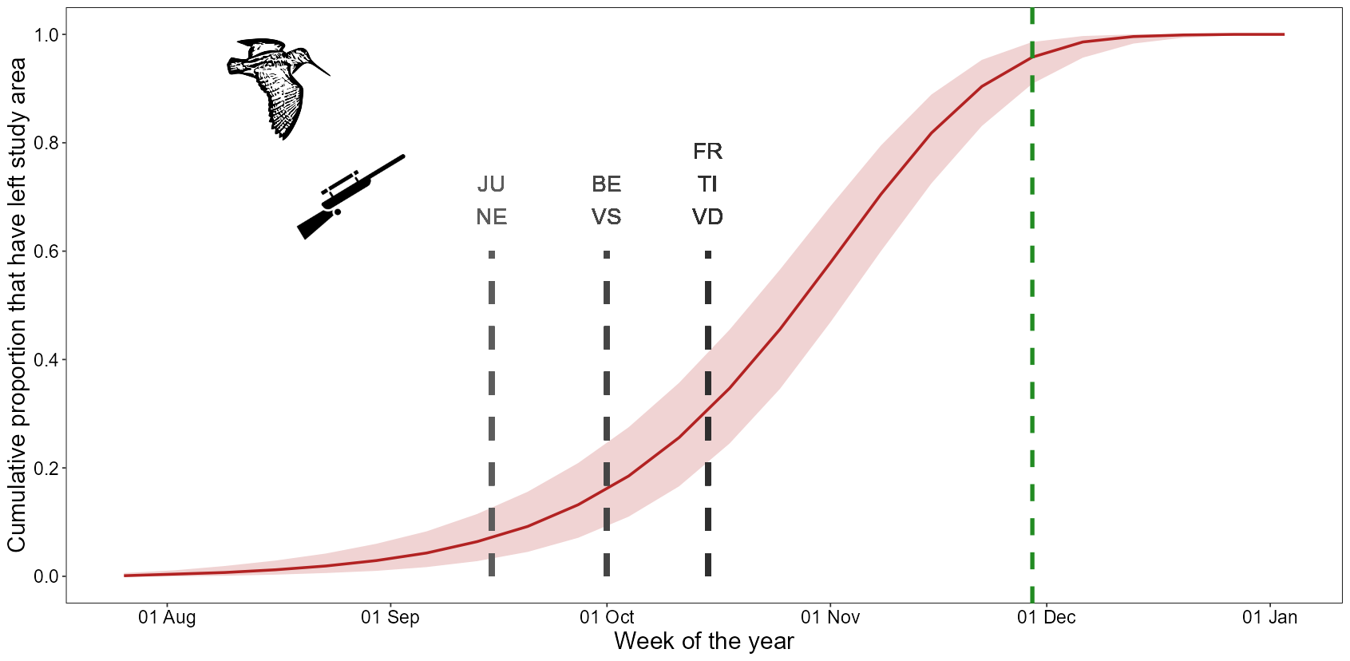
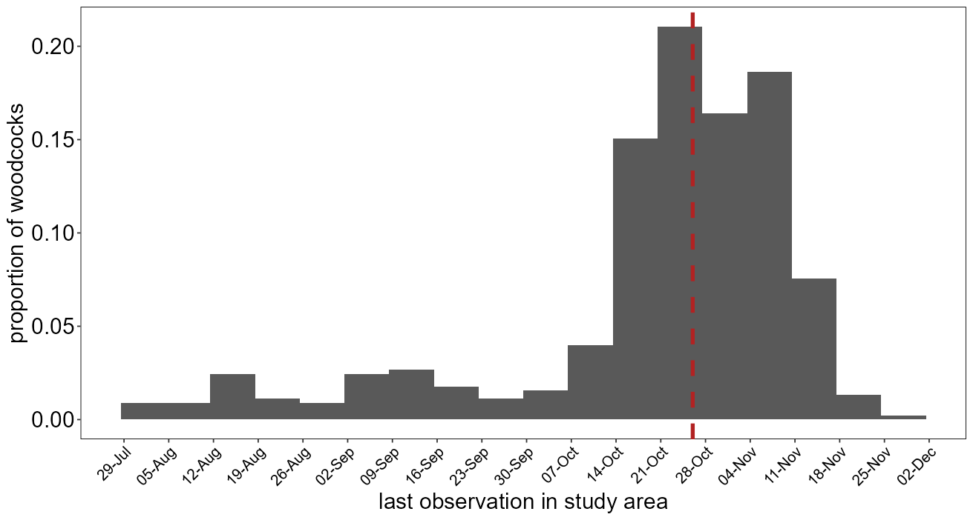
Woodcocks depart late in autumn
based on VHF and GPS tracking of 467 bird-years in Swiss forests
median last observation day is 26 October (middle of hunting season)
65 - 94% present at beginning of hunting season (varies by canton)

Slide 17
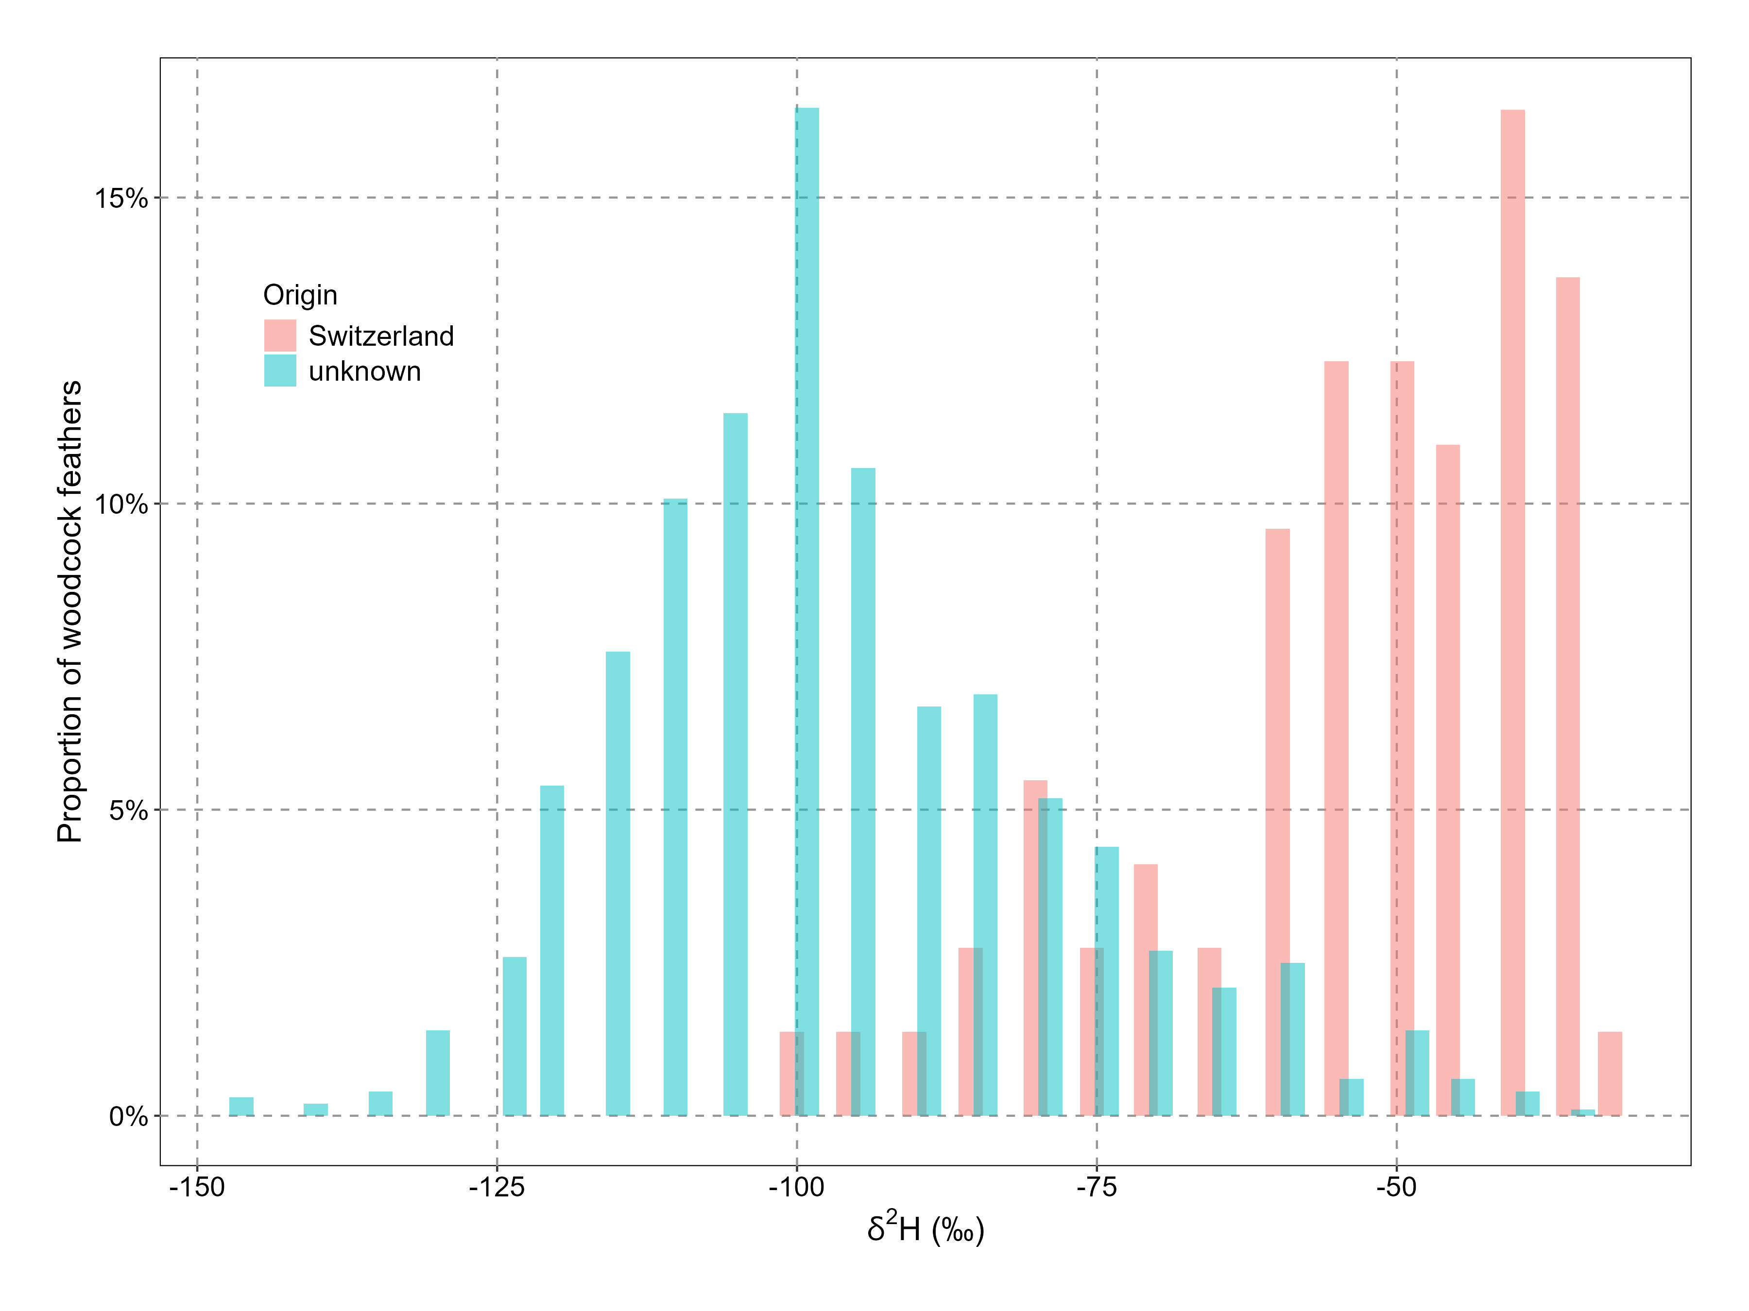
Hydrogen isotope ratios of woodcock feathers
wide range of δ²H_{feather} for shot birds of unknown origin (blue)
substantial overlap with δ²H_{feather} from Swiss birds (red)

Slide 18
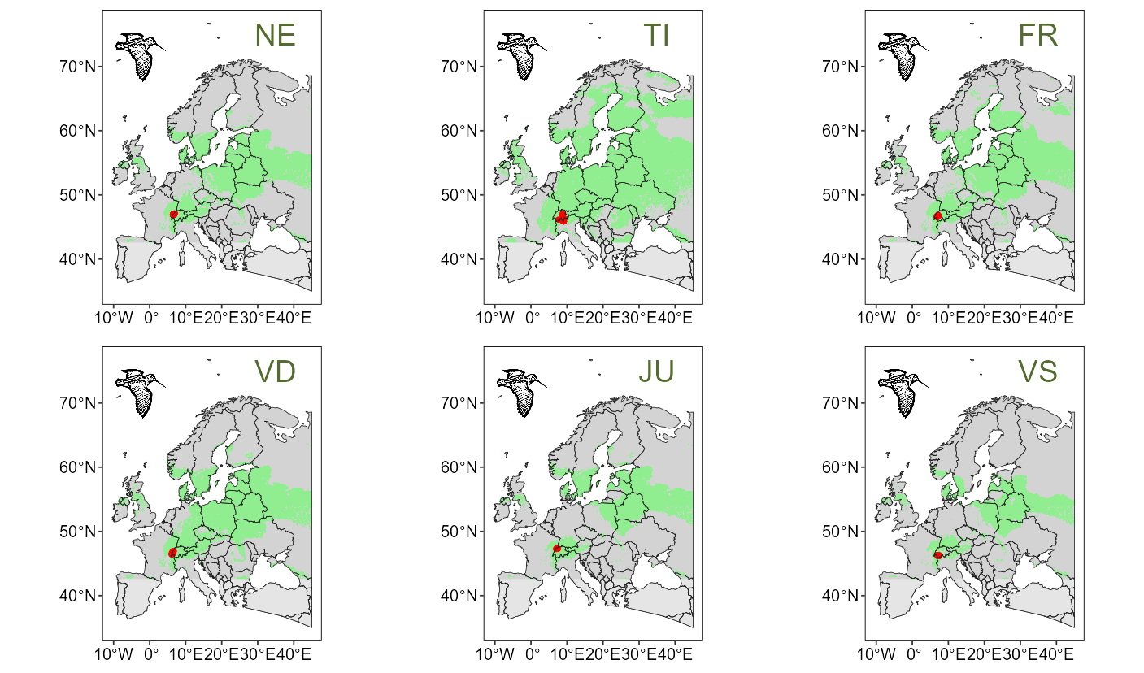
Isotopic ambiguity of origin
maps of Europe where δ²H_{feather} would be indistinguishable from Swiss birds
birds originating from those areas would be considered ‘local’ in our model

Slide 19
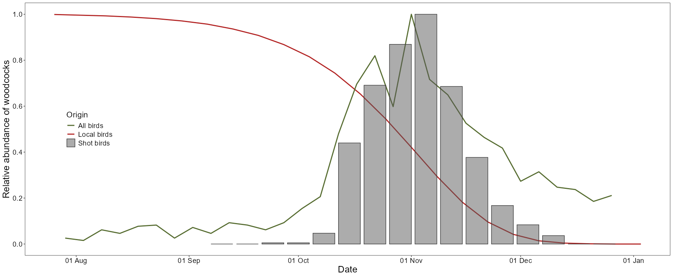
Including time of shooting to improve assignment
estimated probability of local birds to still be present (red line)
relative index reflects overall abundance (including non-local birds (green line)

Slide 20
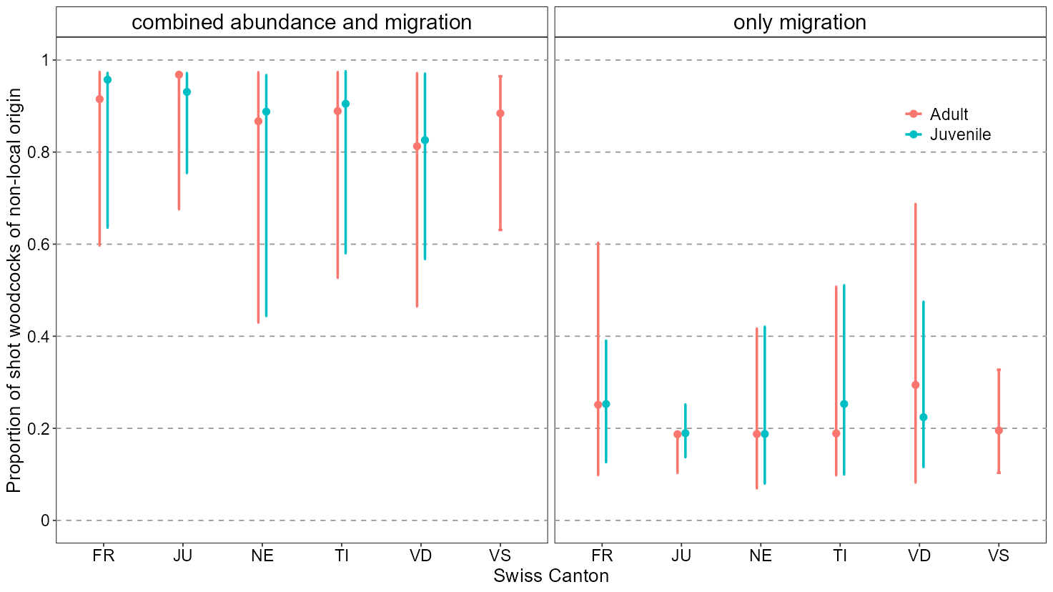
Proportion of shot woodcocks of non-local origin
based on 842 individuals of unknown origin (9% of total Swiss hunting bag)
estimated proportion mostly dependent on prior information

Slide 21
Extrapolation of hunting mortality
breeding population 2000 – 8000 birds
annual hunting bag 1820 shot woodcocks (average 1985 – 2024)
we estimated 0.2 - 54% of the shot birds to be local (= 36 - 983 woodcocks)
in our sample 28.8% of shot woodcocks were adult (=10 - 283 adult woodcocks)
represent 0.1 - 14% of Swiss breeding population
small proportion compared to hunting mortality elsewhere (only 8% of shot woodcocks were shot in Switzerland)

Slide 22
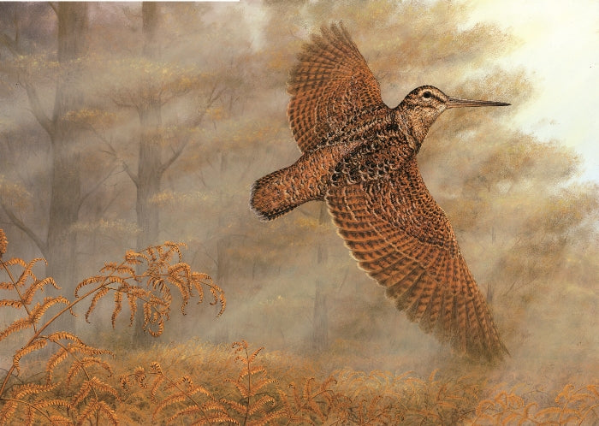
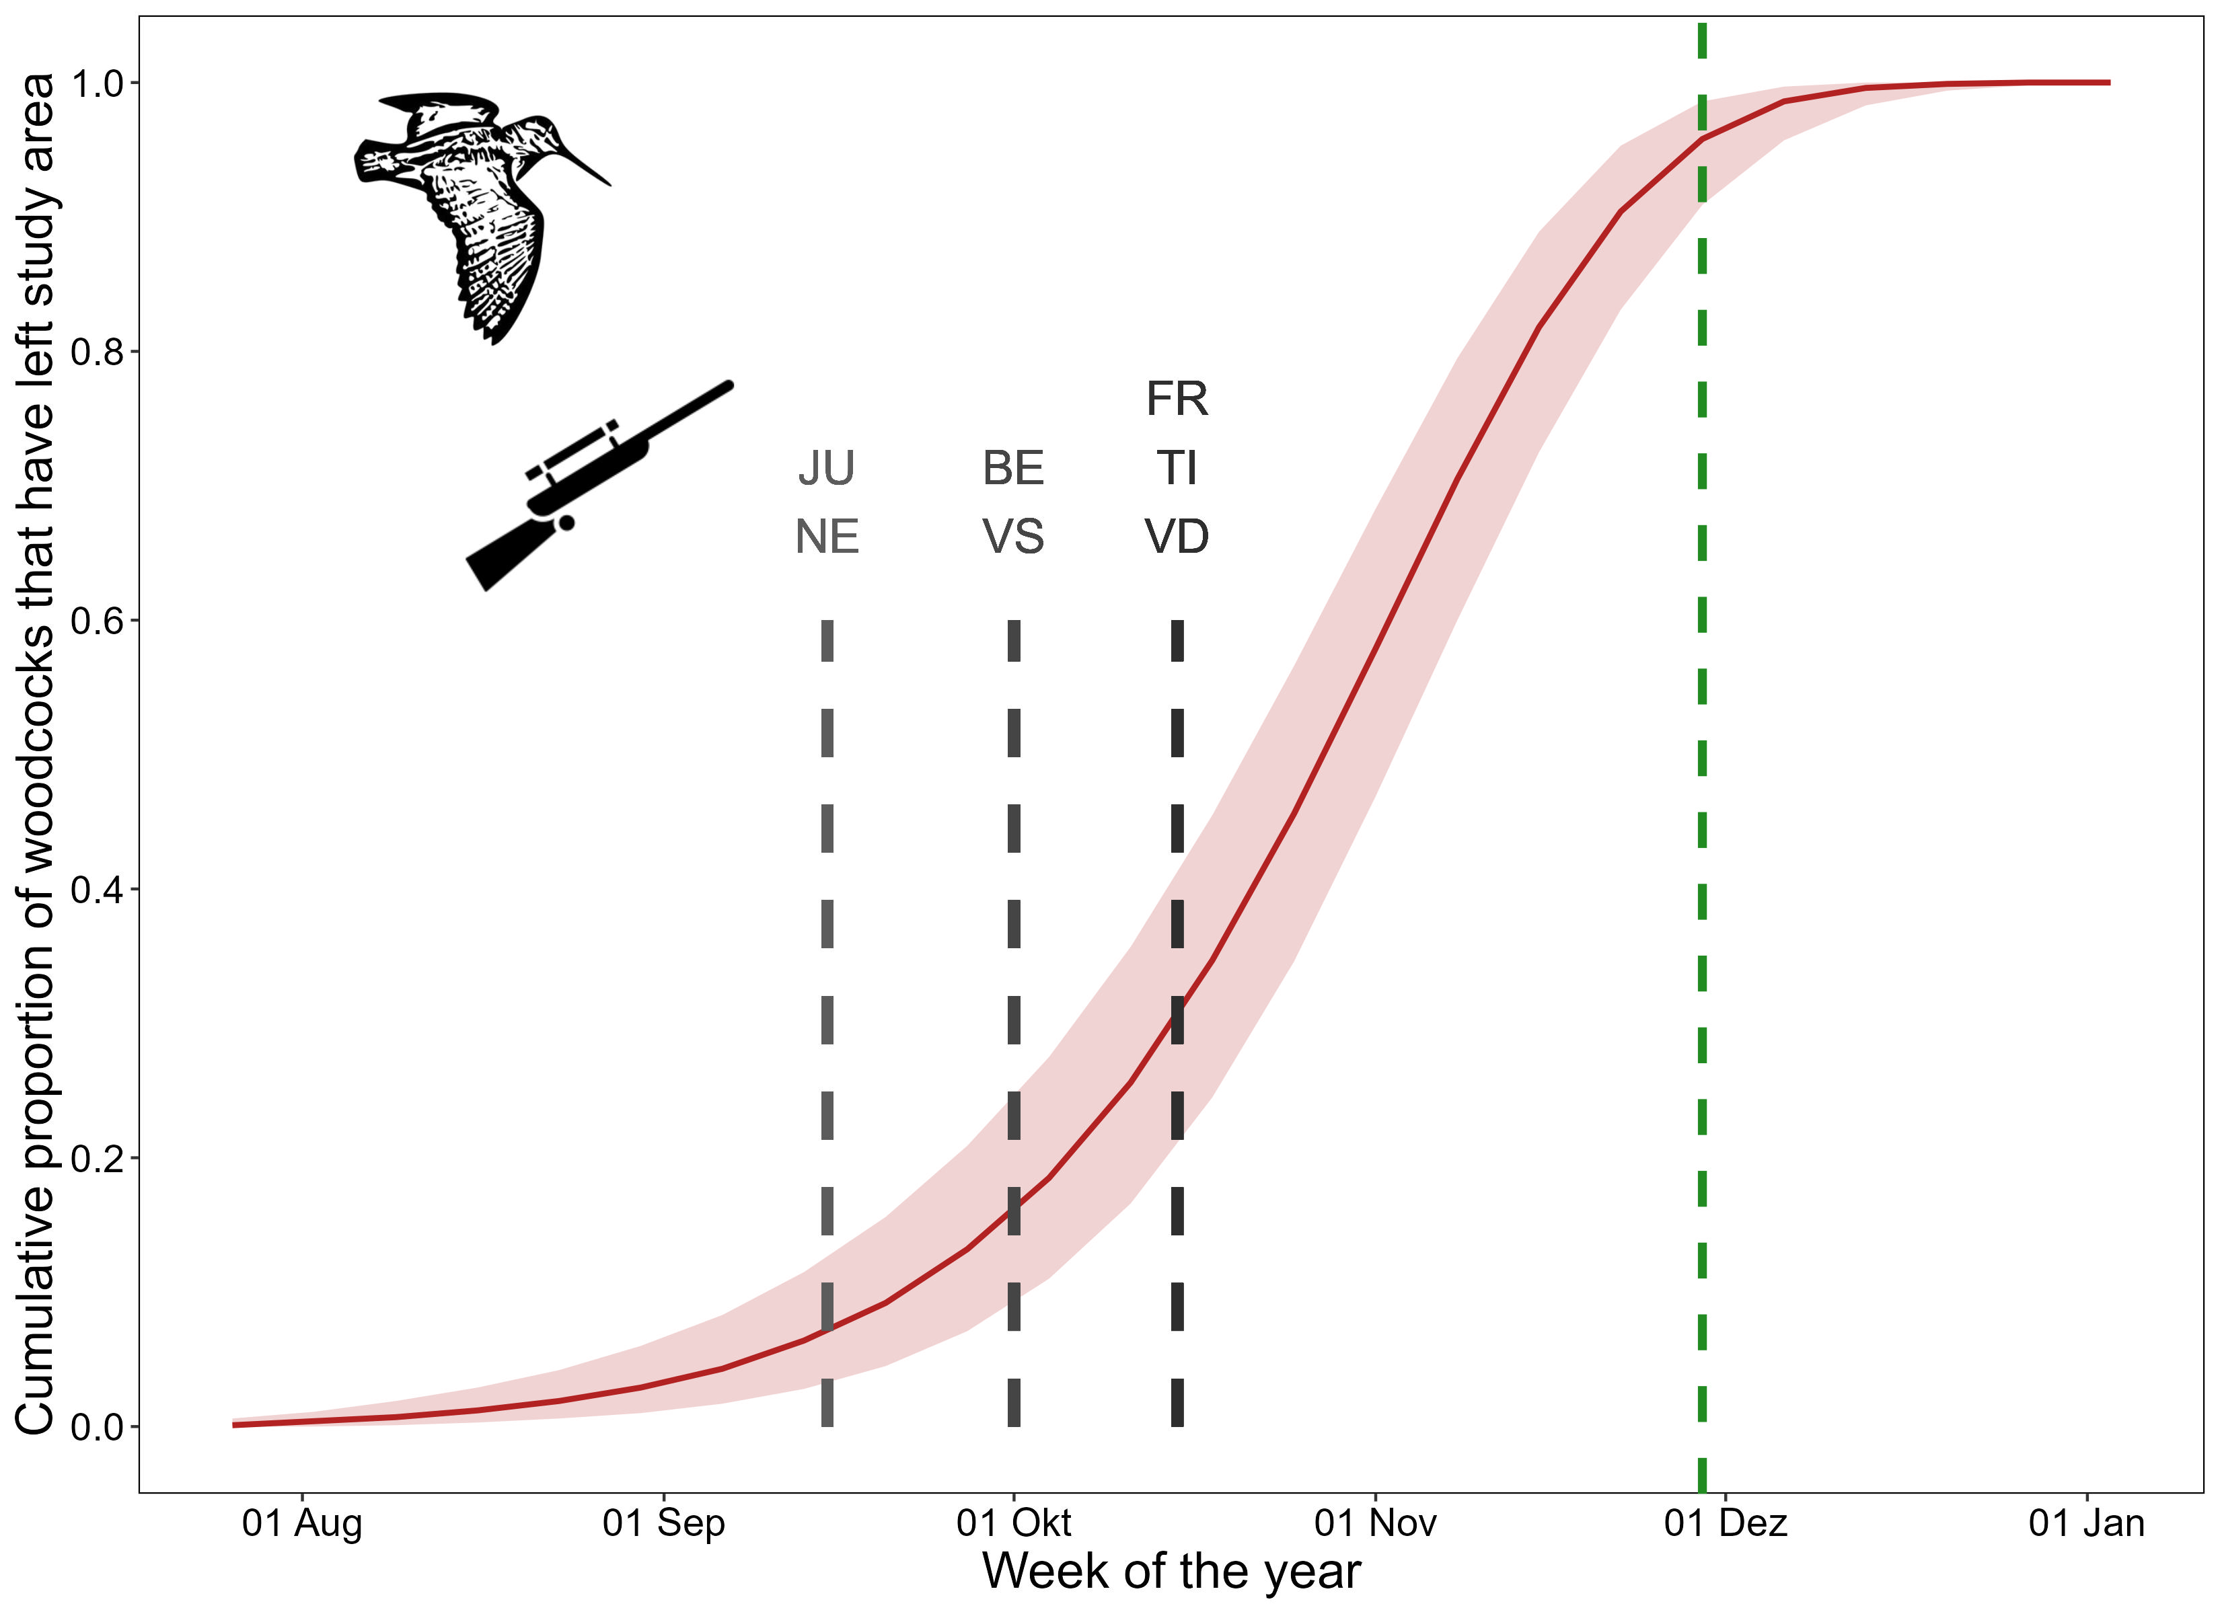
We cannot determine origin of shot woodcocks
hydrogen isotopes too variable and inconclusive to infer origin
timing suggests that most Swiss woodcocks are exposed to hunting
huge effect of abundance prior indicates overriding effect of dilution
if we want to protect local woodcocks then delayed start of hunting season would be the simplest option

Slide 23
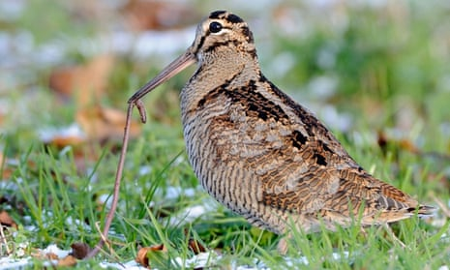
Conclusions
shooting migratory birds may be desirable from a Swiss perspective, but may harm other populations we know very little about
hunting in Switzerland not greatest source of mortality, but one that could be removed by national legislation – Switzerland could lead by example to request any changes in other countries

Slide 24
A few final words from the conservation viewpoint
The project’s scientific advisory board came to the conclusion that
there’s no need to abandon woodcock hunting in Switzerland altogether (the situation is not severe enough), but that
hunting pressure should be reduced, and that
the cantons are better suited for restricting hunting pressure than the federal government, because they have the possibility to limit directly the maximal bag numbers, whereas the federal government can only limit the overall hunting season
Most cantons have indeed set additional restrictions from 2022 onwards. The goal is smaller bags. So far, so good 😃
But also so far, there has been no success 😢 (because of the importance of TI)
→ Monitoring for a few years more, and then re-evaluation of the situation!

Slide 25
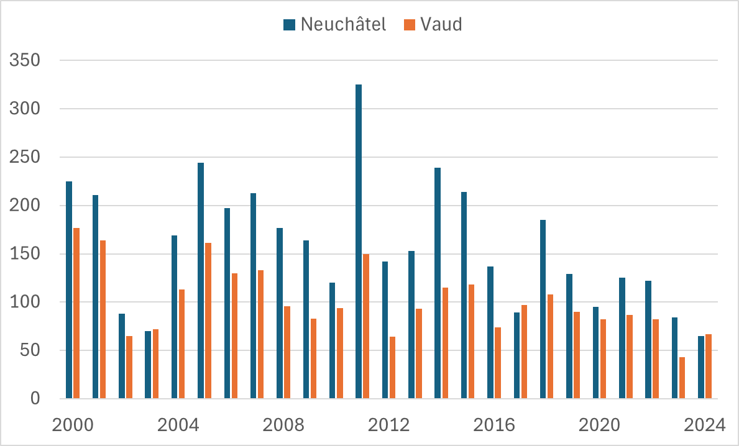
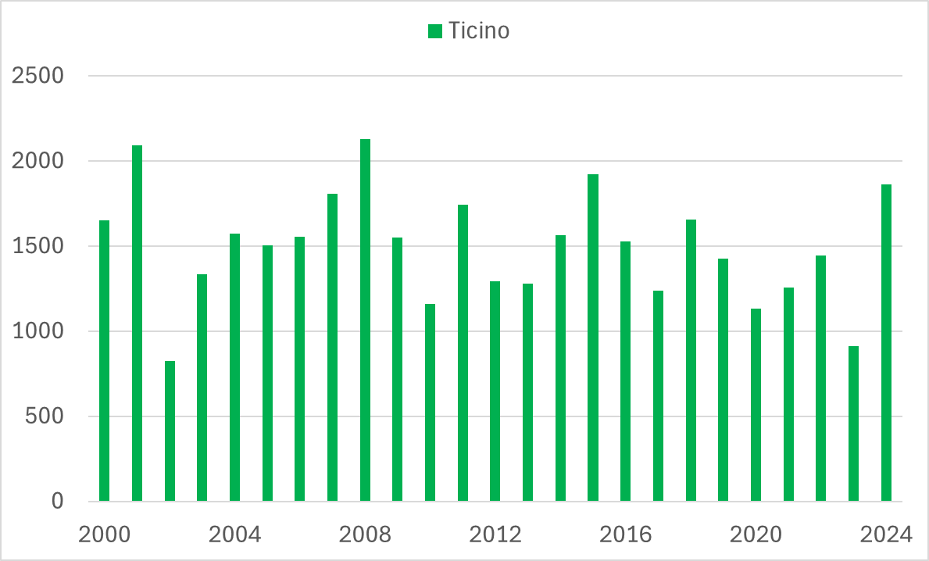
A few final words from the conservation viewpoint
New cantonal restrictions
Hunting bags 2000 - 2024

Slide 26
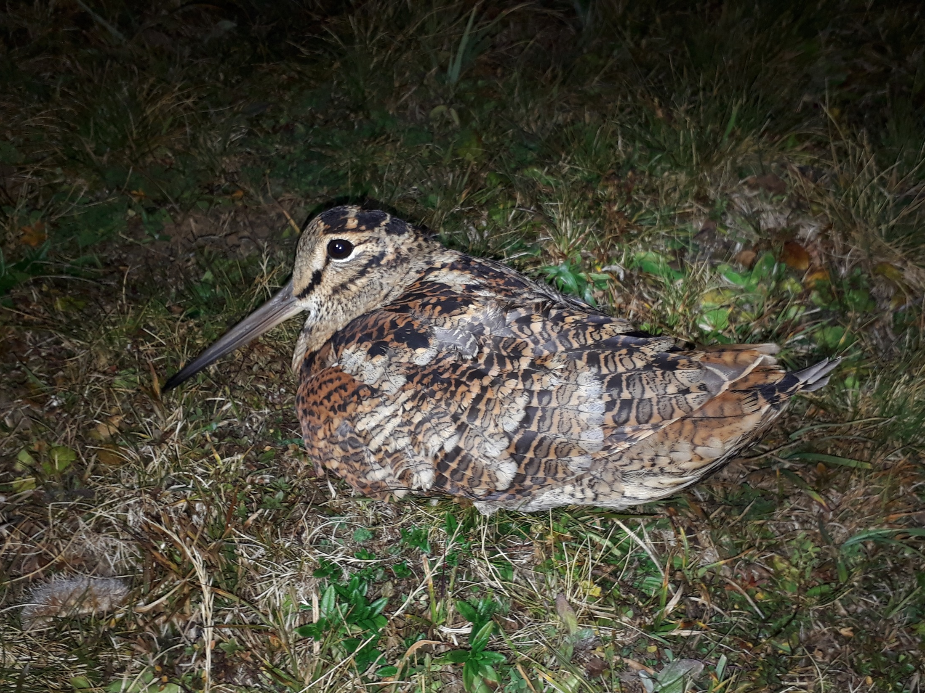
Thank you
Lorenza Marconi, Jérôme Gremaud, Romain Fürst, Henri Descombes, Yann Fragnière, Nicolas Pasquier, Yann Rime, Florence Bovay, Jan Naef, Sandrine Seidel, Charlotte Warburton, Samuel Jordan, Henri-Armand Meister, Yves Lanoir, Francis Anker, Victor Ulrich, Thierry Barbier, Giuliano Viali, Stéphane Regazzoni
Christian Voigt, Stephanie Kramer-Schadt, Lukas Jenni, Thierry Bohnenstengel, Yves Gonseth, Benjamin Homberger
Andrew Hoodless, Adele Powell
Pius Korner

